Slide 1

E-Project

Slide 2
Welcome

Slide 3
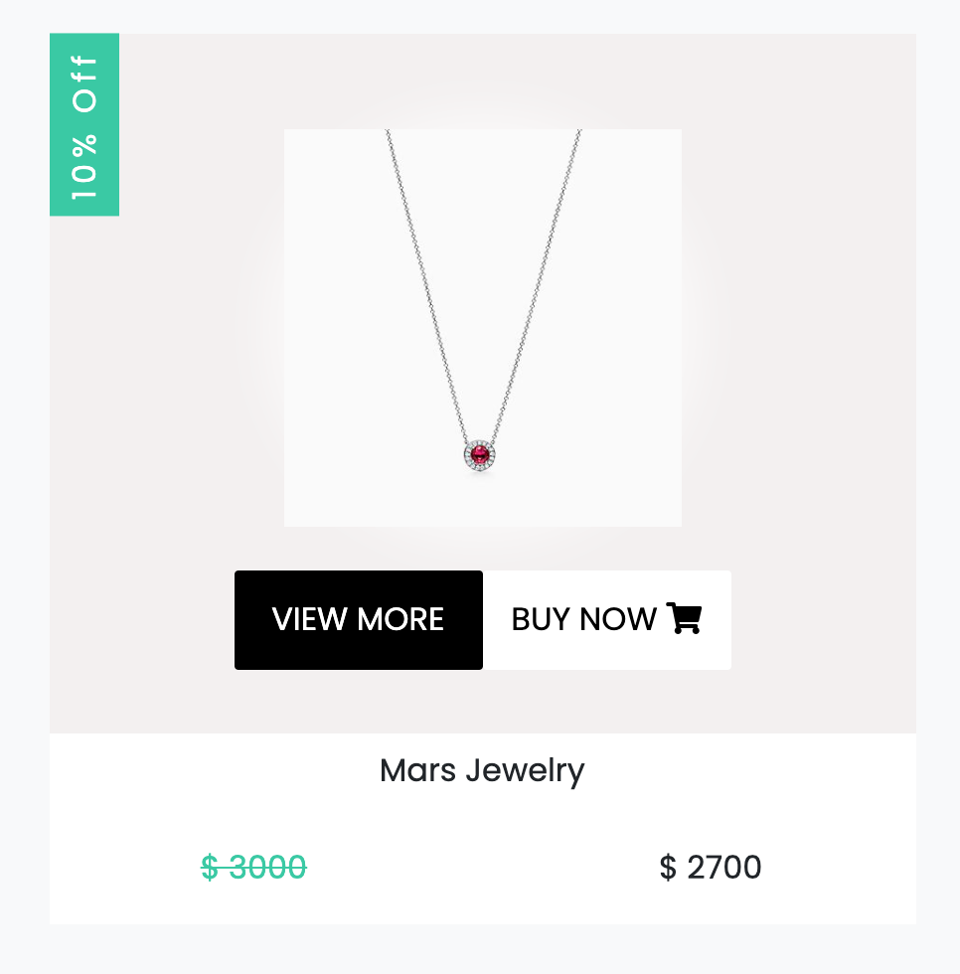
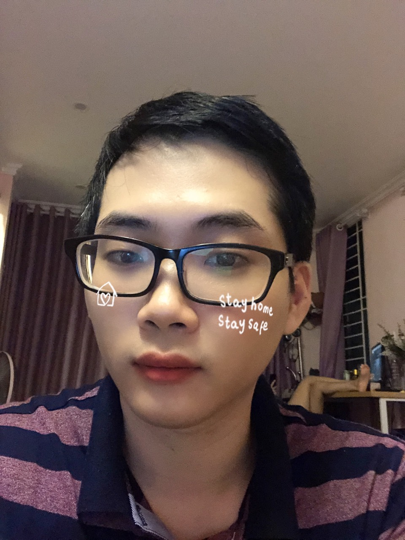
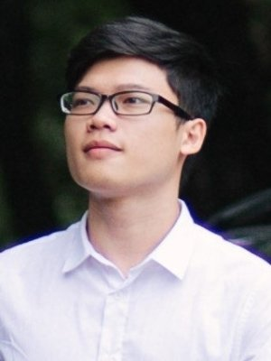

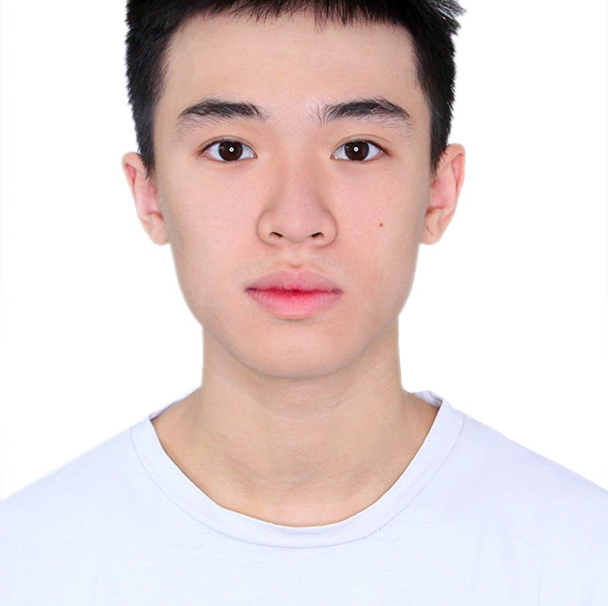
Mentor and my team
Mentor
Student
Student
Nguyễn Vũ Quang
Nguyễn Vũ Nam
Lưu Bình Minh
Student
Student
Student
Nguyễn Hoài Nam
Trần Phương Nam
Nguyễn Quang Minh

Slide 4
About Project

Slide 5
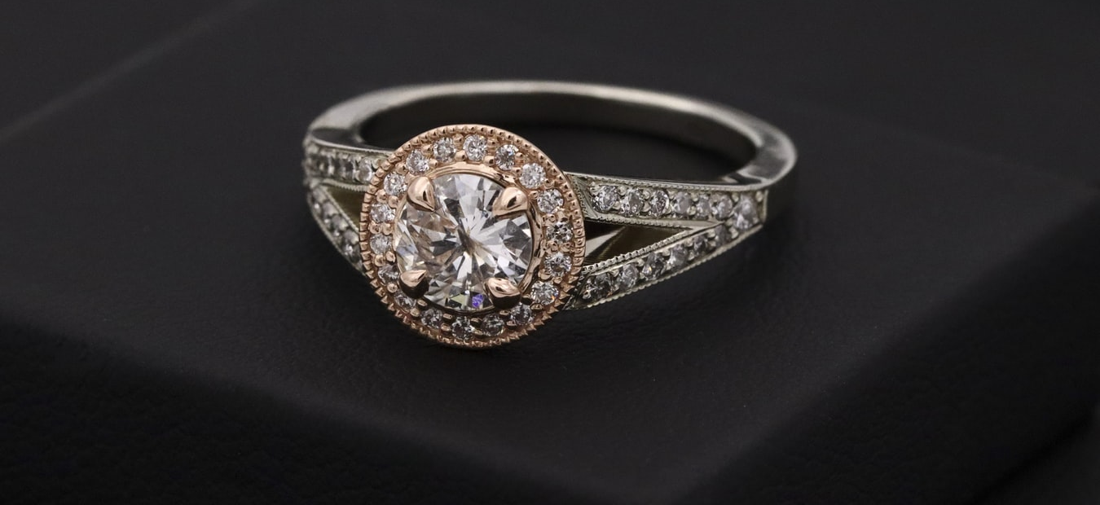
About Project
Crystal
Today, people are drawn to crystals for a number of reasons, including primarily that they are very beautiful objects and their different shapes, sizes and colours have proved fascinating and mysterious as well. They can be found in various forms of beautiful jewellery, or on their own in rough uncut specimens that are sometimes used as ornaments to decorate homes.
01
02
03
Crystals are used to enhance the body's own healing abilities, reduce stress and improve the quality of your life. They hold a massive amount of energy and those who work with them believe that they have their own individual energy field or personality.
Crystals or placing them on your body is thought to promote physical, emotional and spiritual healing. Crystals supposedly do this by positively interacting with your body's energy field, or chakra. While some crystals are said to alleviate stress, others purportedly improve concentration or creativity
Crystals can be found in various forms of beautiful jewellery, or on their own in rough uncut specimens that are sometimes used as ornaments to decorate homes.

Slide 6

About Project
Problem Statement
A need is felt to develop a site which will give all necessary information and also will list the various products. The website is to be developed based on following requirements.
Requirement
The Web site is to be created based on the following requirements. There should be pages as mentioned below
Home About Us
Special Offers New
Arrival Products
Contact Us

Slide 7
About Project
Solutions
01
02
03
04
HTML
CSS
JAVA SCRIPT
BOOTSTRAP
Used to build layouts for websites
Used to decorate HTML, create styles that make the website more perfect and complete
Used to create interactions between users and the website
Used to make layout easier for web developers

Slide 8
Result

Slide 9
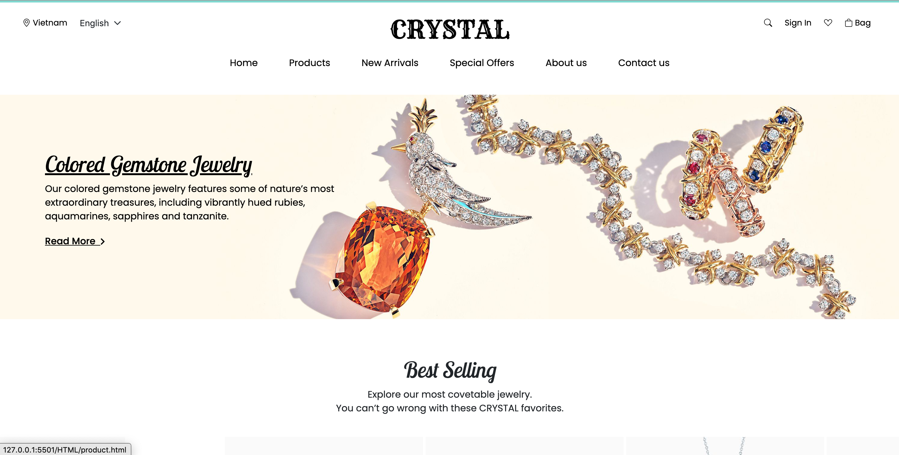
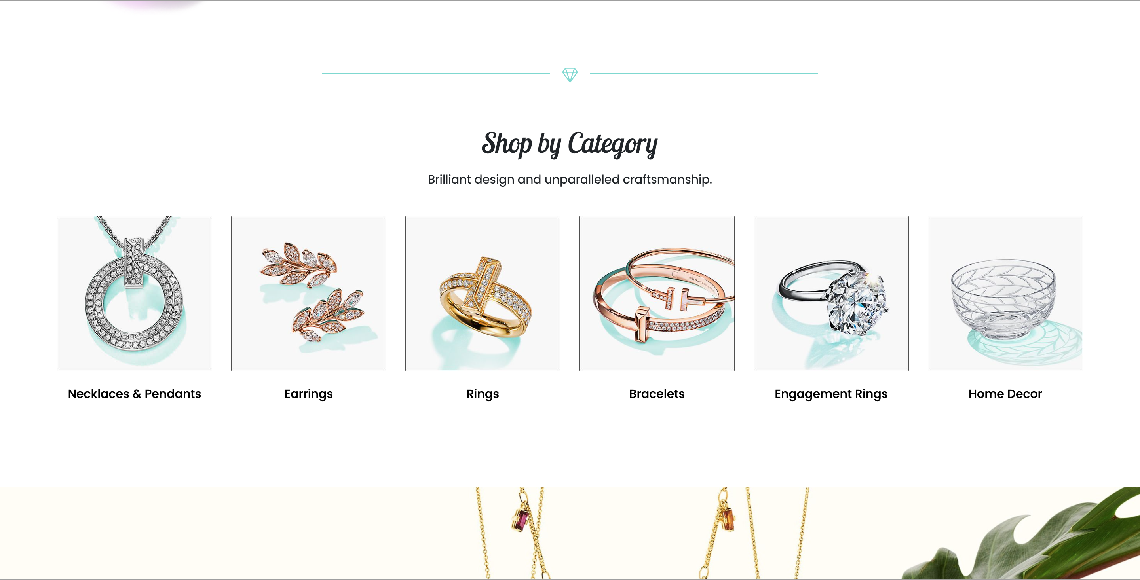
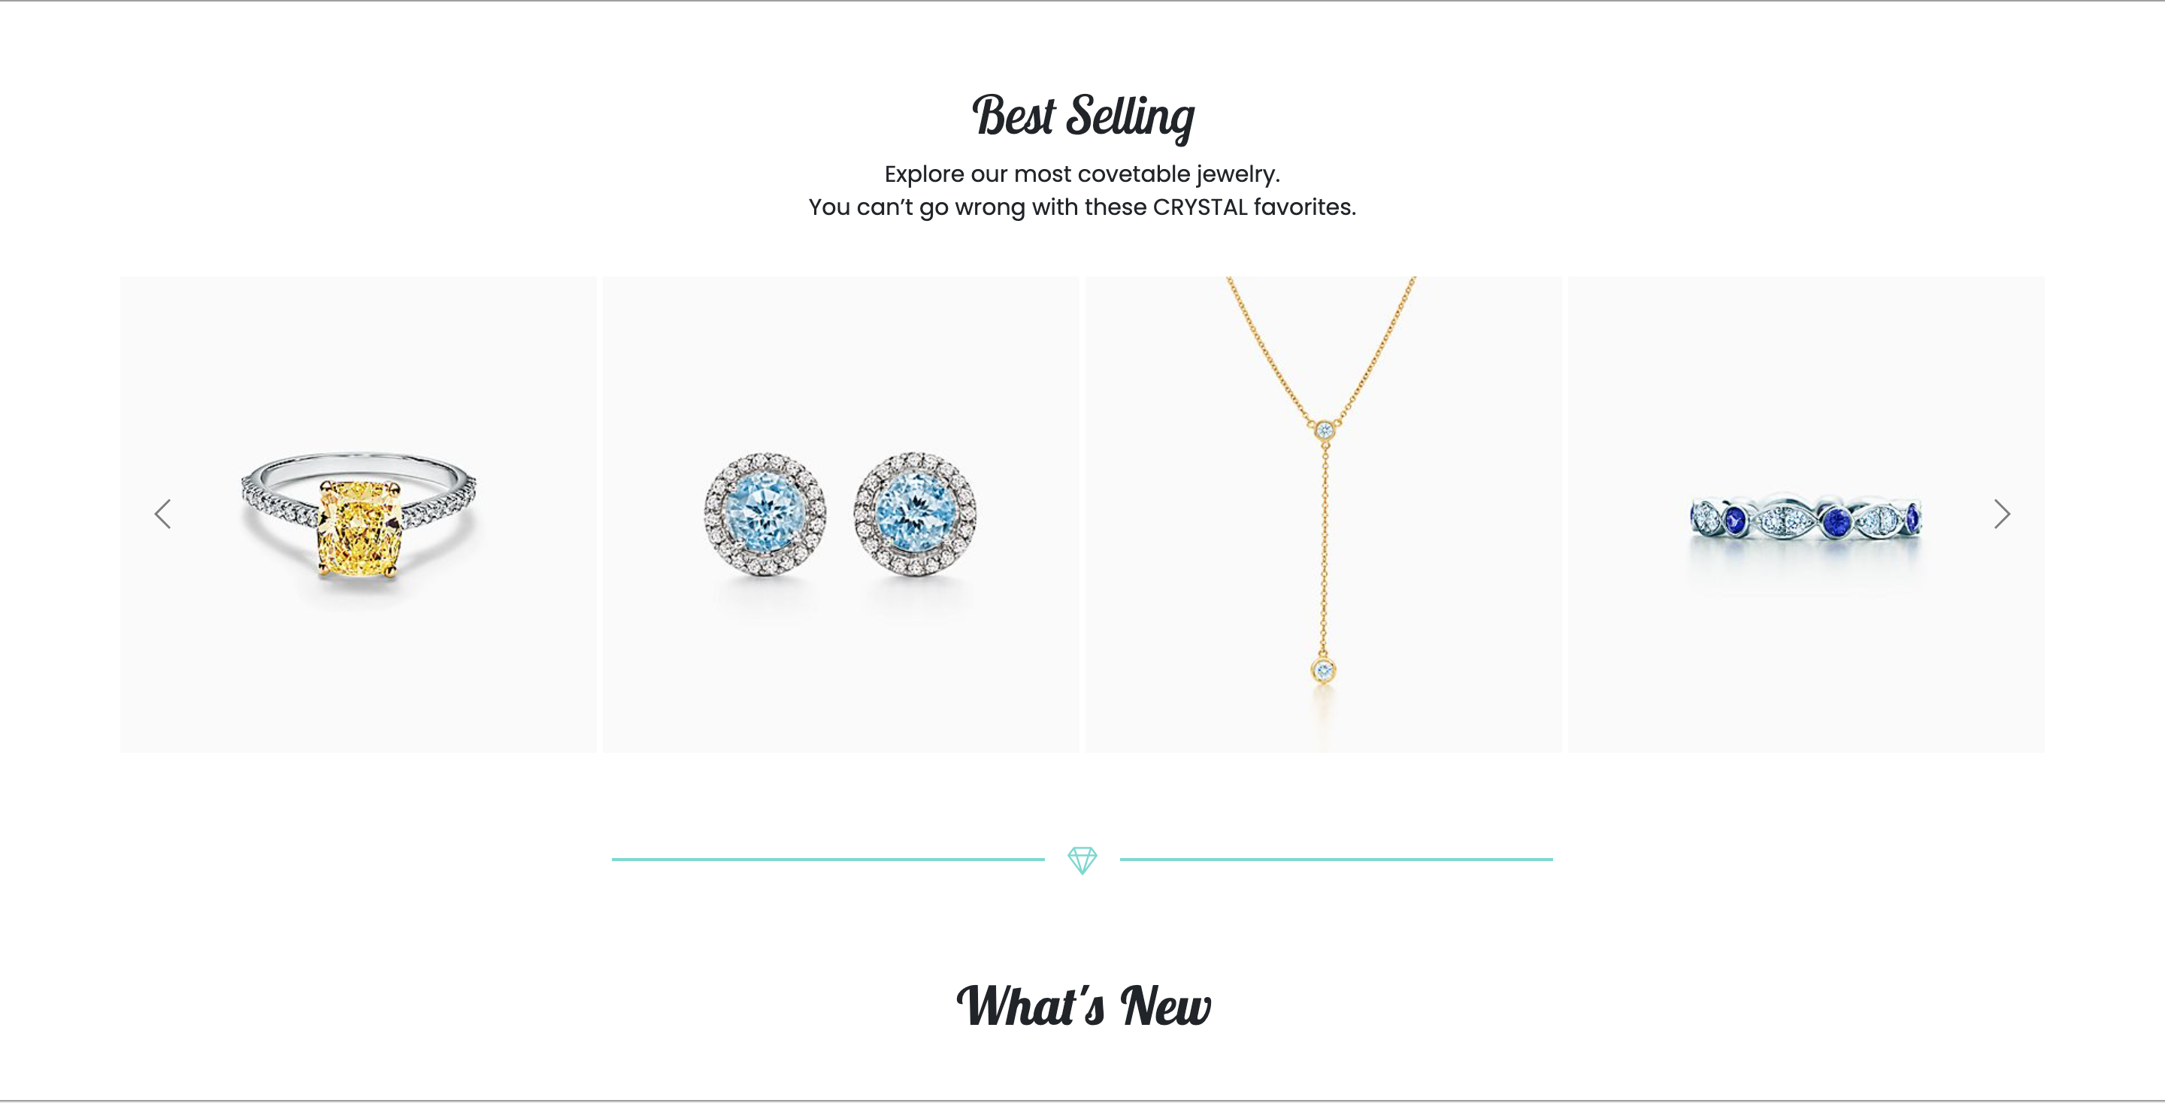
Result
1
The Home Page should be created making use of Sections with a suitable logo, the header section can be added which will show images of various products.

Slide 10
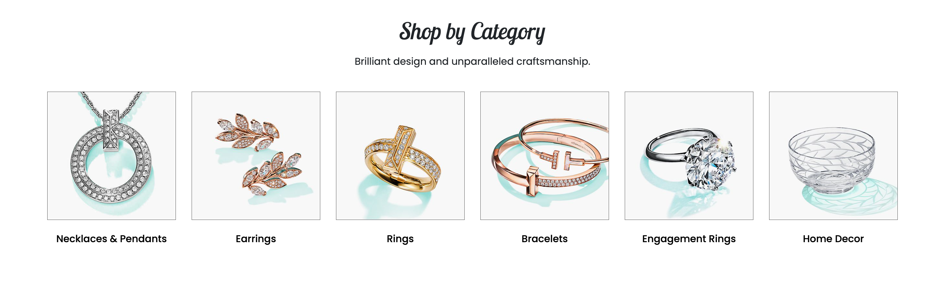
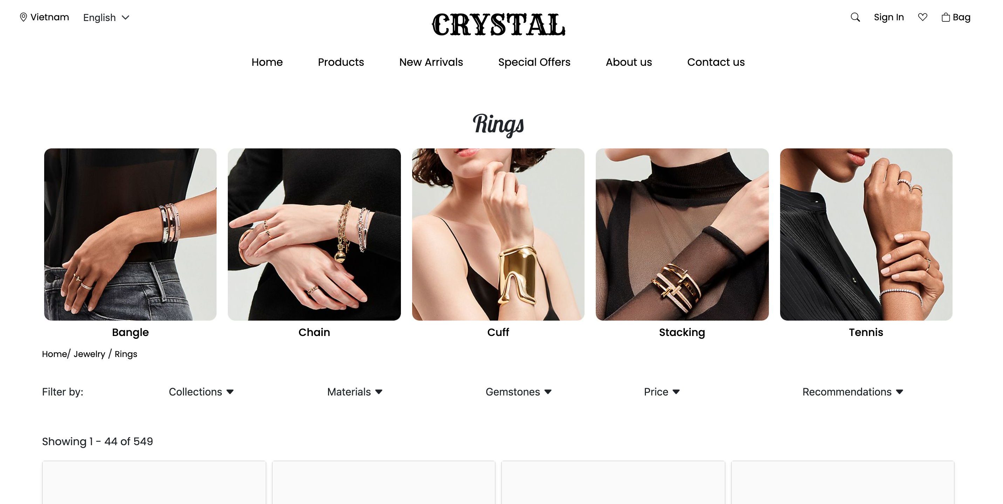
Result
2
The site must contain the links to navigate through any category for the information.

Slide 11
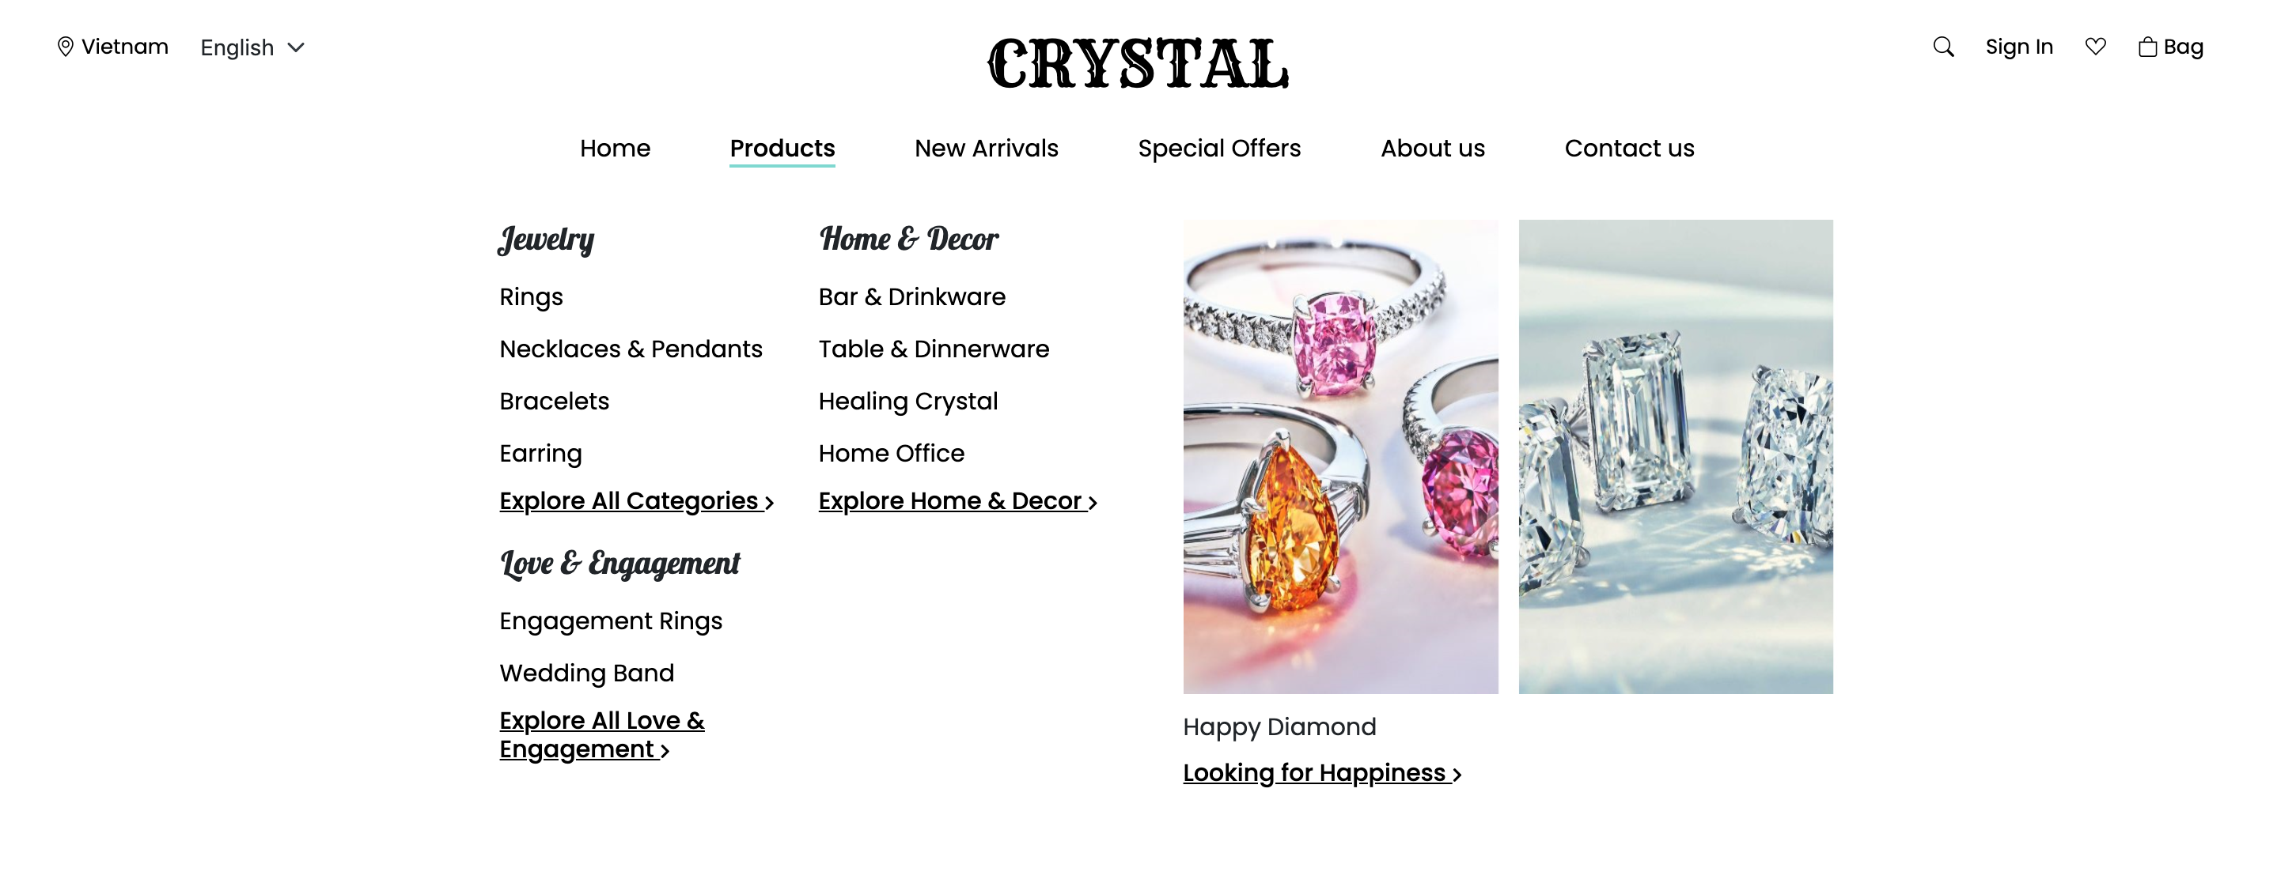
Result
3
The site should display a menu which will contain the options for brief introduction about the various products available, location of the shop and any other information if required.

Slide 12
Result
4
The information should be categorized according to the various crystals like if a User wants to see only “Diamond/Amber/Amethyst etc” products then he/she can click on a Link/button/menu etc and can see only that crystal products.

Slide 13
Result
5
When a user selects any particular crystal, a list of all the products for that crystal will be displayed

Slide 14
Result
5
When a user selects any particular crystal, a list of all the products for that crystal will be displayed

Slide 15
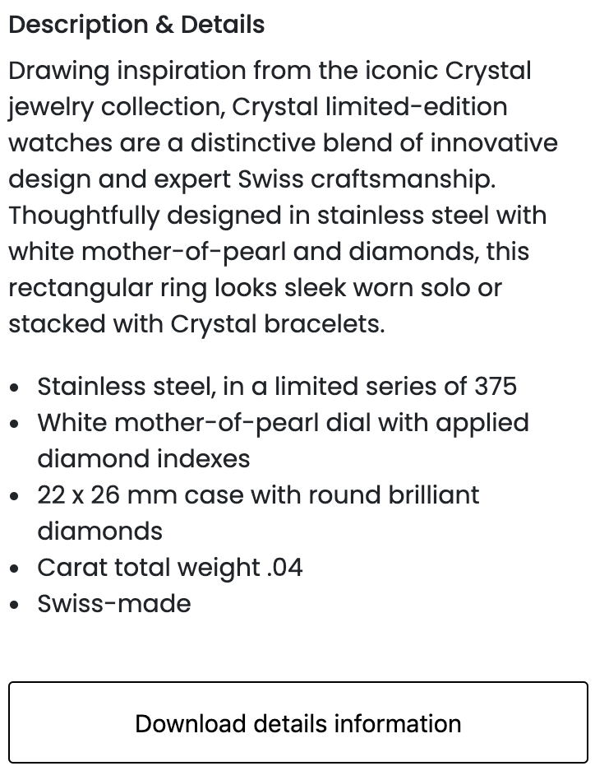
Result
6
A brief summary of features of the product should be displayed on the Web Page along with the picture but detailed Features should be stored in Individual Word documents which can be downloaded or viewed by the User who wishes to see the same.

Slide 16
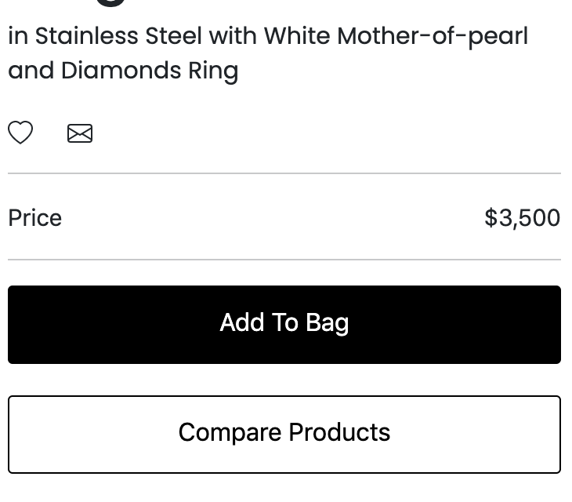
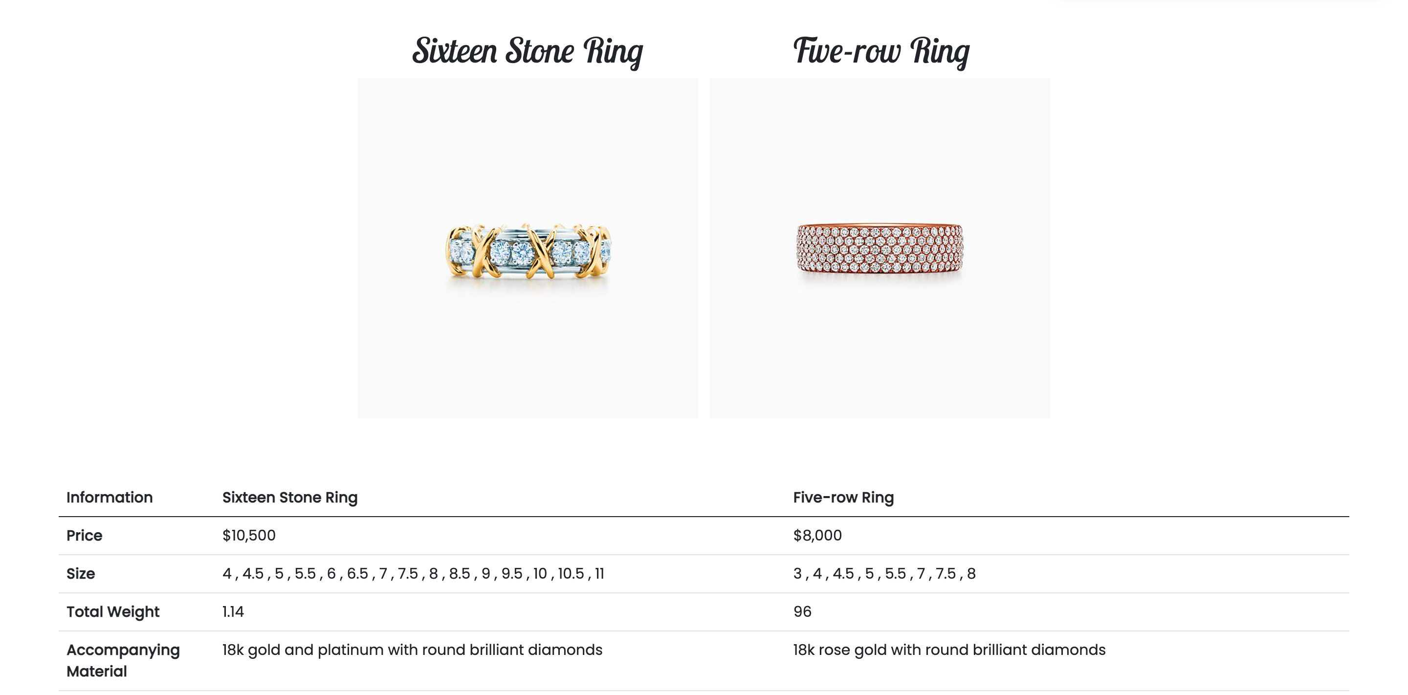
Result
7
The user should also be able to compare the various products

Slide 17
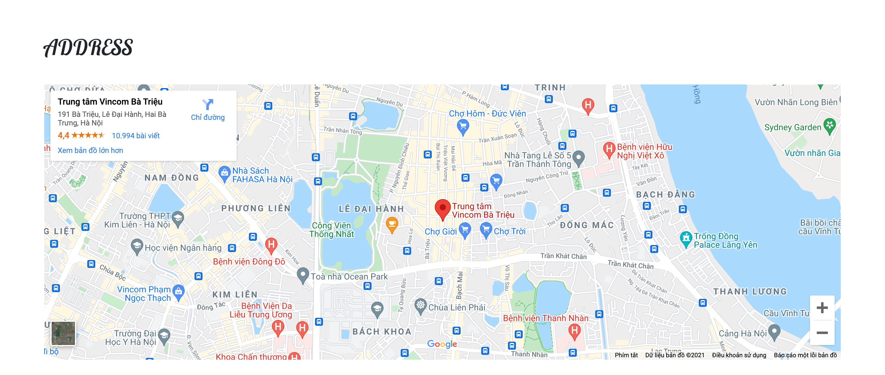
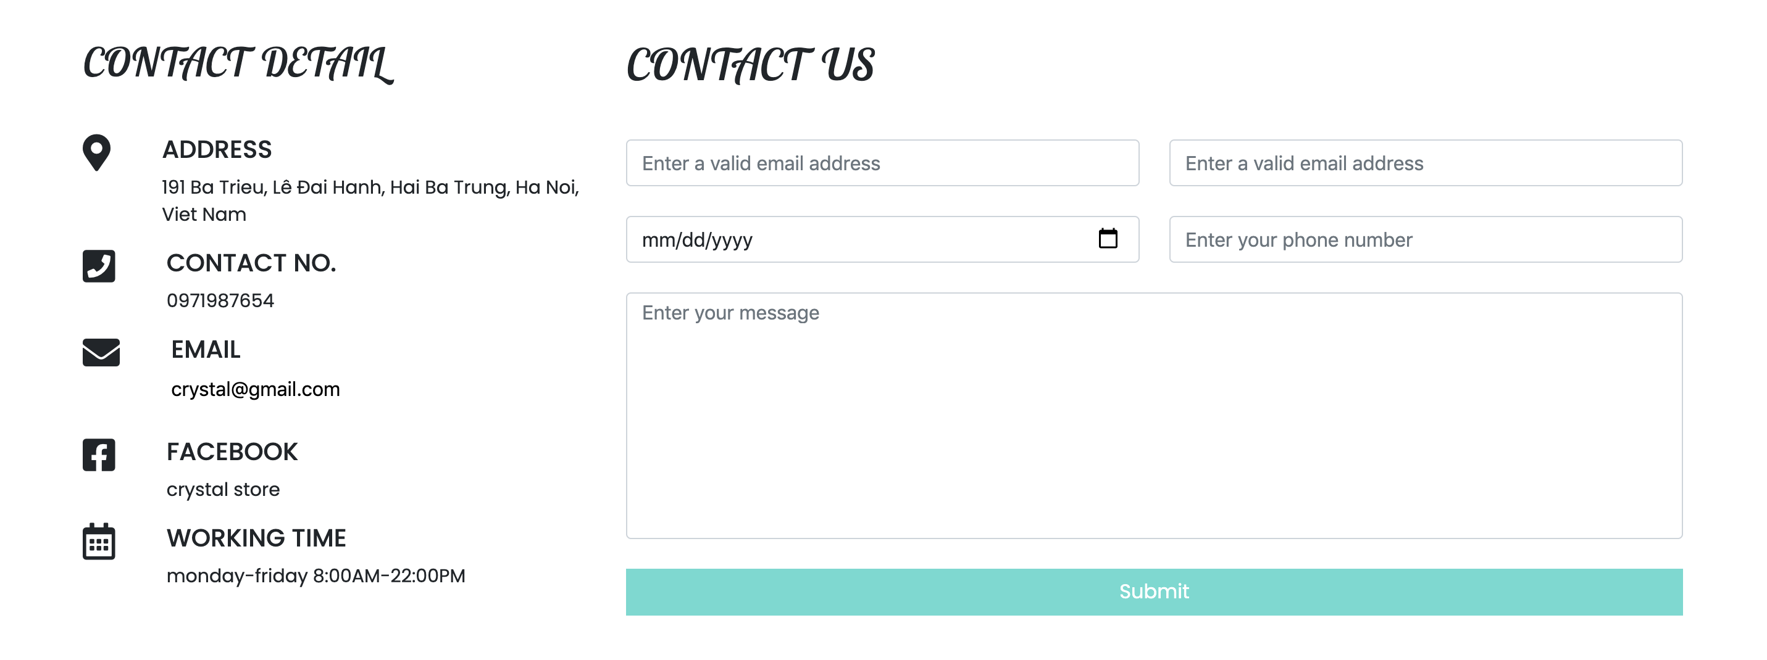
Result
8
There should be a “Contact Us” page which will have the Address of the Company which should be displayed using GeoLocation API (eg. GoogleMaps) and the email address which when clicked will invoke the local mail client from where they can send an email.

Slide 18


Responsive

Slide 19
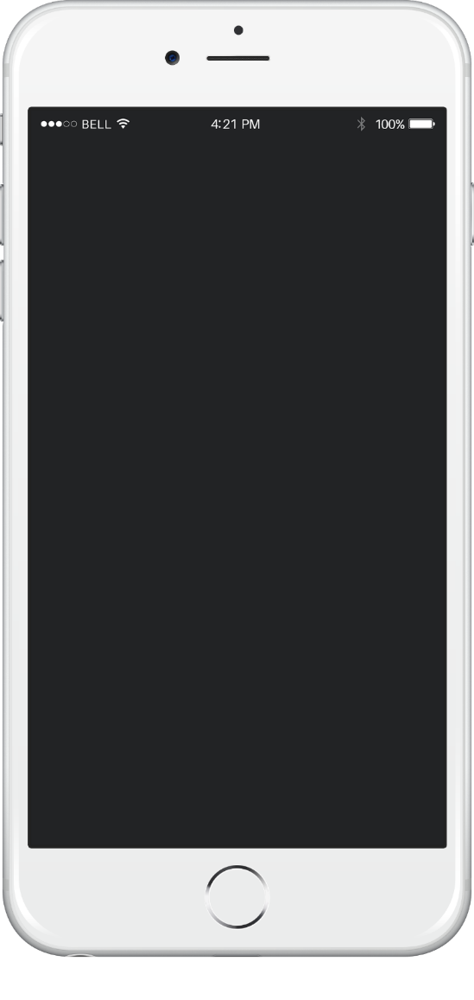
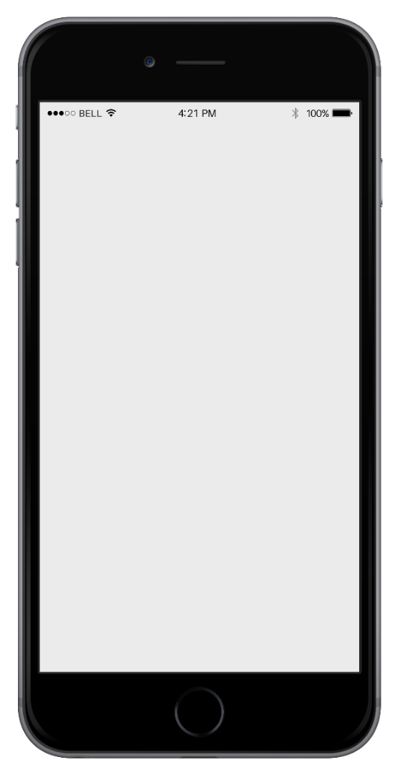
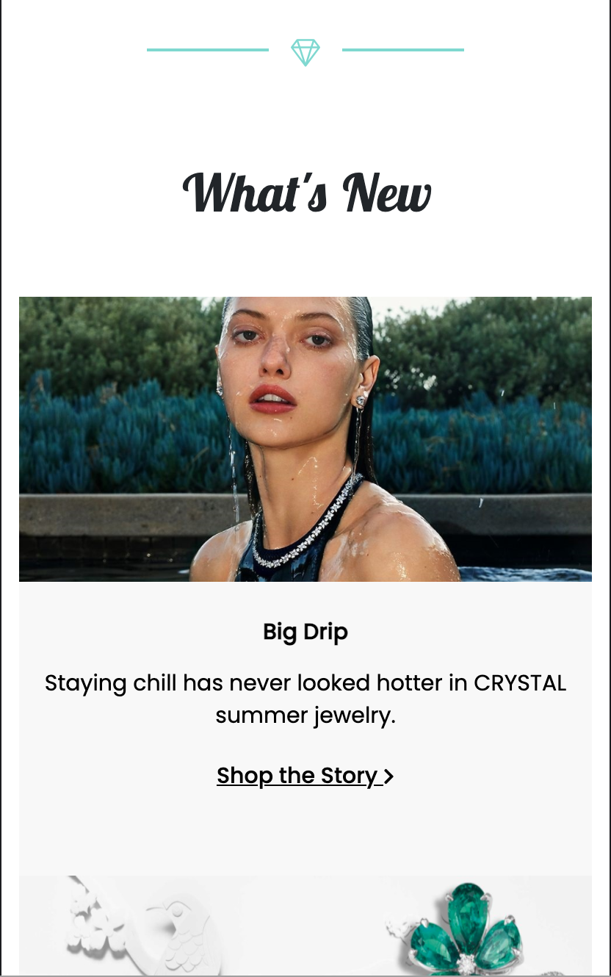
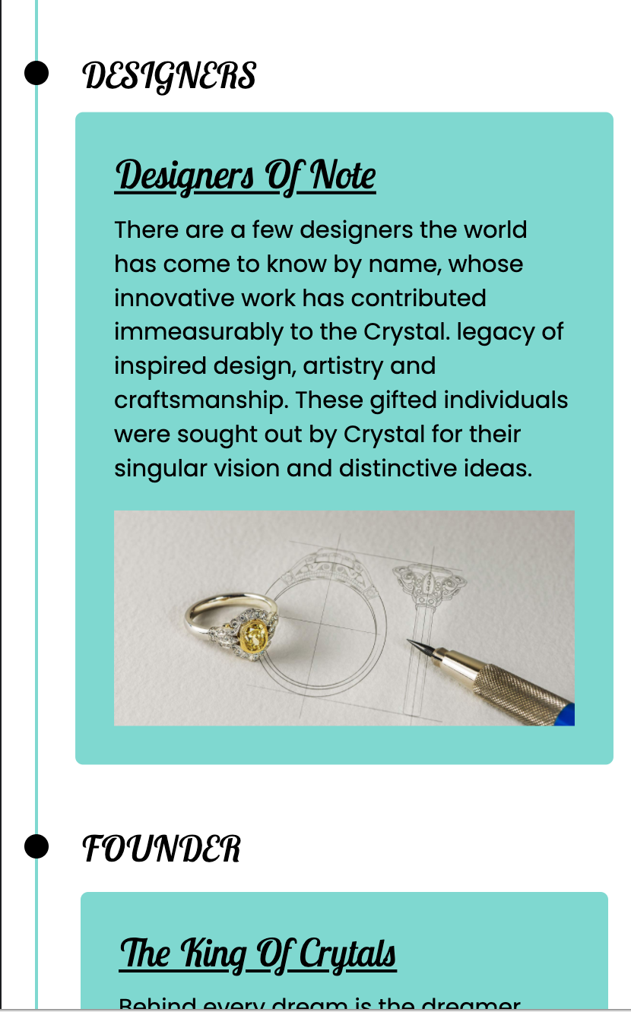
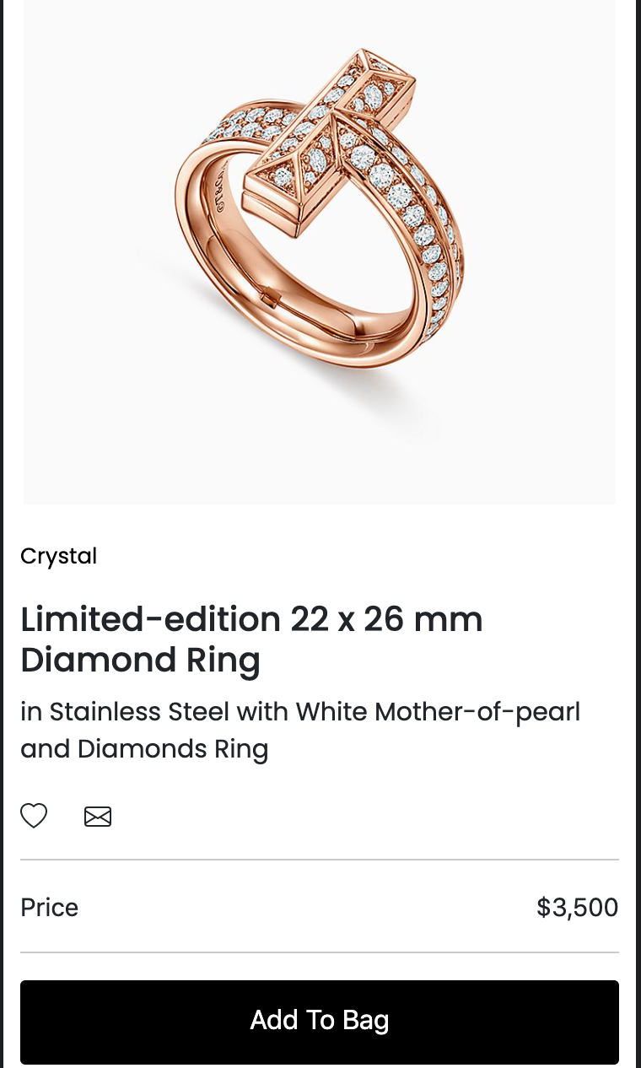
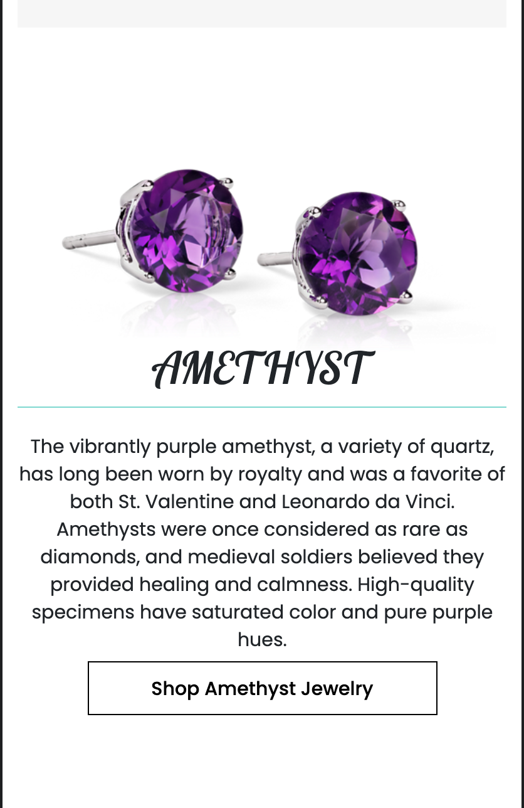
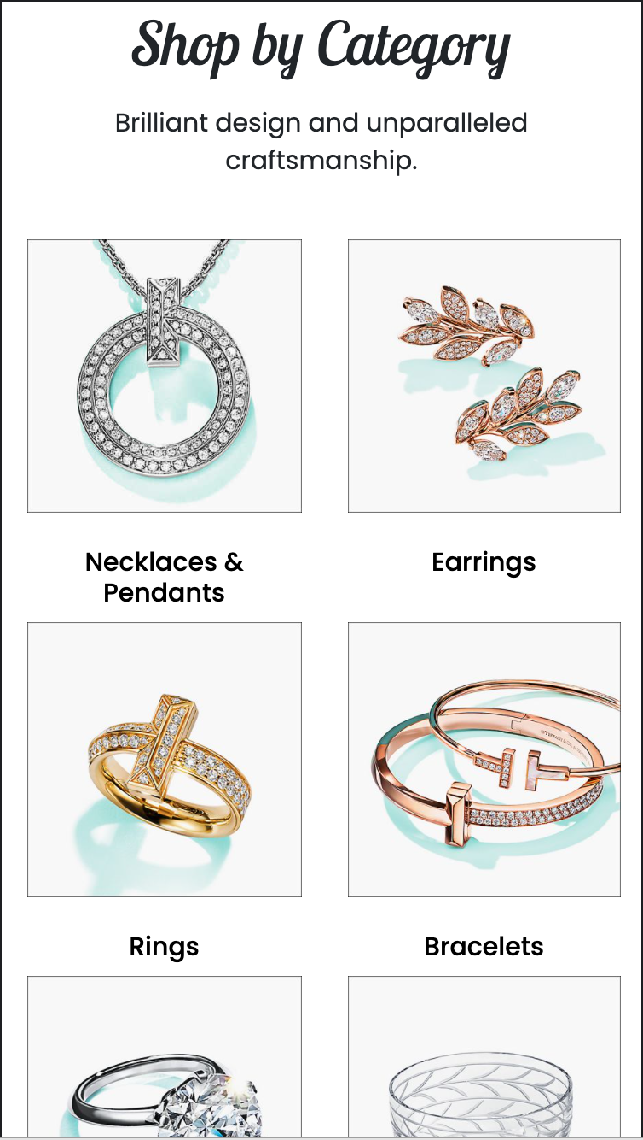
Responsive

Slide 20
Discuss

Slide 21
Discuss
Advantages
Weakness
_ Can be manipulated easily for users
_ Using Bootstrap is easy and fast for developers
_ One more reliable place to shop for jewelry and crystals
_ The website is built with the main color to highlight the solemnity
_ Meet the criteria set by the customer
_ The product is limited in quantity
_ Code is not optimized
_ Code is difficult to manage and find

Slide 22
Thank You

Slide 23
Thank You
For The Attention

